Slide 1




Azure Function,Logic Apps & Blob Storage for .NET Developer
www.dotnetmastery.com

Slide 2
Azure Functions
Blob Storage
Logic Apps
Azure Cache
for Redis

Slide 3
Containers and Blobs in Blob Storage
Managing Blobs and Containers in Azure Portal
Managing Access
CRUD operations on Blobs from .NET application
CRUD operations on Containers from .NET Application
Blob Metadata
Securing using SAS Token (Blob/Container/Storage Account)
Blob Storage

Slide 4
Azure Functions fundamentals and benefits
Azure Functions in Azure Portal and Visual Studio
Http Trigger, Queue Trigger, Blob Trigger, Timer Trigger Functions
Dependency Injecting Dbcontext in Azure Functions.
Serverless Azure Functions (CRUD Operations API)
Azure Functions

Slide 5
Logic Apps fundamentals and benefits
Logic Apps in Azure Portal
Http Trigger, Queue Trigger, Blob Trigger, Timer Trigger Functions
If-else, Switch Case, foreach, until and variables with Logic Apps
Logic Apps

Slide 6
Caching Overview and Benefits
Why Azure for Redis Cache
Implement Azure for Redis Cache in .NET Core Project
Invalidating Redis Cache
Azure Redis Cache

Slide 7
PREREQUISITES
DOTNETMASTERY

Slide 8

Check Q&A Section
Google!
Raise a new Question in Q&A

Slide 9
What this course is not about?
DOTNETMASTERY

Slide 10
PROJECT RESOURCES
DOTNETMASTERY

Slide 11
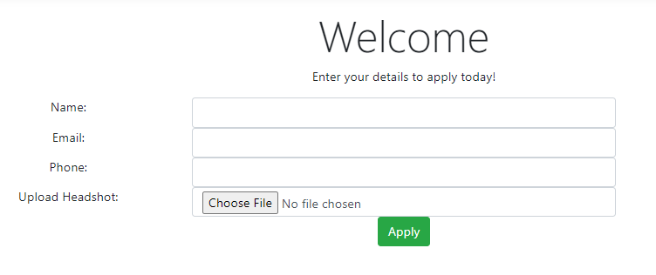


LOGIC APP FLOW
Write to SQL
Upload Blob
/logicappholder
Send Email
Azure Blob Storage
Make a copy in dropbox
/logicappholder-processed/nonimages/
Copy to folder
Copy Blob
zip
pdf
other
/logicappholder-processed
NO
Copy to folder
Copy to folder
Copy to folder
Check if Image
Is
Image
/logicappholder-processed
/nonimages/zip
/logicappholder-processed
/nonimages/pdf
/logicappholder-processed
/nonimages/other
YES
Copy to folder
Delete all blob copies (other than pink box)
/logicappholder-processed/images/

Slide 12




Data
Website
Azure SQL

Slide 13
In-memory
key/value pairs
Website
Azure Cache
Azure SQL

Slide 14
In-memory
key/value pairs
Data in cache?
No
Add to cache
Website
Azure Cache
Azure SQL
Get data from Database

Slide 15
In-memory
key/value pairs
Data in cache?
Returns data
Website
Azure Cache
Azure SQL

Slide 16
Provides in-memory data
Flexibility & performance
Fully Managed
Security & Availability
Azure Cache
for Redis

Slide 17
1. Flexibility & performance –
Azure Cache offers support for various Redis versions so organizations can choose which version works best for them. It also ensures that if the application supports Redis, it will run with Azure Cache for Redis. Azure Cache helps organizations focus on freeing up entangled resources, enabling organizations to improve core business practices and overall efficiency. Azure Cache achieves this by handling millions of requests per second with sub-millisecond latency via a fully managed service with automatic patching, scaling, and provisioning. Additionally, in-memory data stores are capable of super-fast performance, with average read or write operations taking less than a millisecond.
2. Security –
Azure offers organizations the best-in-class enterprise security solutions. Azure strives to ensure that data remains protected in its systems by receiving more certifications than any other cloud provider. Microsoft is also known to spend more than 1 billion USD annually on cybersecurity, with more than 3,500 security experts making it one of the most highly secure cloud servers.
3. Availability –
Azure Cache has built-in high availability, the goal of which is to ensure that Redis instances remain live in case of an outage in its underlying VMs. The primary purpose of using multiple VMs in this setup is to increase the availability percentage rates. It does this by using multiple VMs, called nodes, for a cache. The nodes are configured so that data replication and failovers happen in a synchronized manner. Azure Cache also gives organizations an option of disaster recovery via Geo-replication. Geo-replication allows them to configure an Azure Cache for Redis instance in a different Azure region to back up their primary cache.
Azure Cache
for Redis

Slide 18
4
AZURE AD B2C – WEB APPLICATION
DOTNETMASTERY

Slide 19
5
AZURE AD B2C - ROLES
DOTNETMASTERY

Slide 20
6
AZURE AD B2C - API
DOTNETMASTERY

Slide 21
Azure Storage
MICROSOFT
Blob
Storage
File
Storage
Table
Storage
Queue
Storage
ACCESS TIER
HOT
COLD

Slide 22
Azure Storage
MICROSOFT
BLOB STORAGE
Blob
Storage
File
Storage
Table
Storage
Queue
Storage
ACCESS TIER
HOT
COLD

Slide 23
Azure Storage
MICROSOFT
Durability and High Availability
Security
Scalability
Accessibility

Slide 24
Azure Blob Storage
Blob Storage
Blob Container
dotnetmastery-pdf
azuredotnetmastery
dotnetmastery-images
dotnetmastery-other
Access level
Private
Blob
Container

Slide 25
Azure Blob Storage
Blob Storage
Blob Container
Blob
dotnetmastery-pdf
rose.png
azuredotnetmastery
dotnetmastery-images
cat.png
dotnetmastery-other
dog.png
Access level
Private
Blob
Container
Access level
Private
Blob
Container

Slide 26
Azure Blob Storage
Blob Storage
Blob Container
Blob
dotnetmastery-pdf
rose.png
azuredotnetmastery
dotnetmastery-images
cat.png
dotnetmastery-other
dog.png
Access level
Private
Blob
Container
https://azuredotnetmastery.blob.core.windows.net/dotnetmastery-images/rose.png
https://azuredotnetmastery.blob.core.windows.net/dotnetmastery-images/cat.png
https://azuredotnetmastery.blob.core.windows.net/dotnetmastery-images/dog.png
https://azuredotnetmastery.blob.core.windows.net/dotnetmastery-images?comp=list

Slide 27
Azure Blob Storage
Blob Storage
Blob Container
Blob
dotnetmastery-pdf
flower/rose.png
azuredotnetmastery
dotnetmastery-images
animal/cat.png
dotnetmastery-other
animal/dog.png
Access level
Private
Blob
Container
https://azuredotnetmastery.blob.core.windows.net/dotnetmastery-images/flower/rose.png
https://azuredotnetmastery.blob.core.windows.net/dotnetmastery-images/animal/cat.png
https://azuredotnetmastery.blob.core.windows.net/dotnetmastery-images/animal/dog.png

Slide 28
Azure AD is Microsoft's
cloud-based identity and
access management service

Slide 29


Presentation Layer
Business Layer
Data Access Layer
Legacy
Modern

Slide 30
Containers and Blobs in Blob Storage
Managing Access
CRUD operations on Blobs from .NET
application
CRUD operations on Containers from
.NET Application
Blob Metadata
Securing using SAS Token
Blob Storage

Slide 31
Function as a Service
Azure Function = Code + Events
Supports different programming language
Azure Functions

Slide 32




Timer
Message
HTTP Request
TRIGGERS
Many More: Azure Blob, SendGrid etc.

Slide 33
Benefits of Azure Functions?
Azure functions are easier to write and deploy.
Lightweight and serverless.
Azure functions are fast to execute
Azure functions are compute-on-demand and that is scalable.
Azure functions do not need any infrastructure and have 0 maintenance.
Azure functions use industry standard
Supports different programming language
Cost-effective pricing
Azure Functions

Slide 34
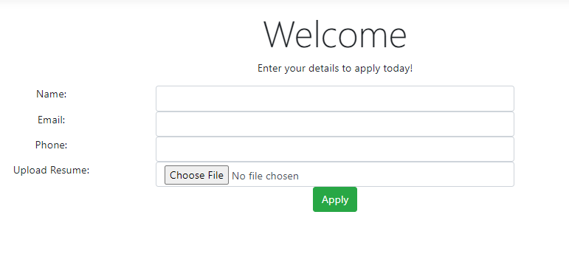

Function App Flow
Write to Queue
Populate SQL Database
Sales
Request
Sales
Request
Upload Blob
Azure Blob Storage
Resize Image
Update Status in Database
Update Status to Completed and Send Email

Slide 35
Build integrated solutions that connect
apps and services together.
Built in connectors.
Logic Apps

Slide 36
Benefits of Logic Apps?
200+ Built in connectors
Serverless architecture
Drag and drop developer experience
Monitoring and Logging
Auto Scaling and High Availability
Cost-effective
Logic Apps

Slide 37


Slide 38


Slide 39


Slide 40
LOGIC APP FLOW
Write to SQL
Upload Blob
/logicappholder
Send Email
Azure Blob Storage
Make a copy in dropbox
/logicappholder-processed/nonimages/
Copy to folder
Copy Blob
zip
pdf
other
/logicappholder-processed
NO
Copy to folder
Copy to folder
Copy to folder
Check if Image
Is
Image
/logicappholder-processed
/nonimages/zip
/logicappholder-processed
/nonimages/pdf
/logicappholder-processed
/nonimages/other
YES
Copy to folder
Delete all blob copies (other than pink box)
/logicappholder-processed/images/

Slide 41
Logic App Flow
Check for new images in folder
Find total Files and send Email
/logicappholder-processed/images/

